Slide 1
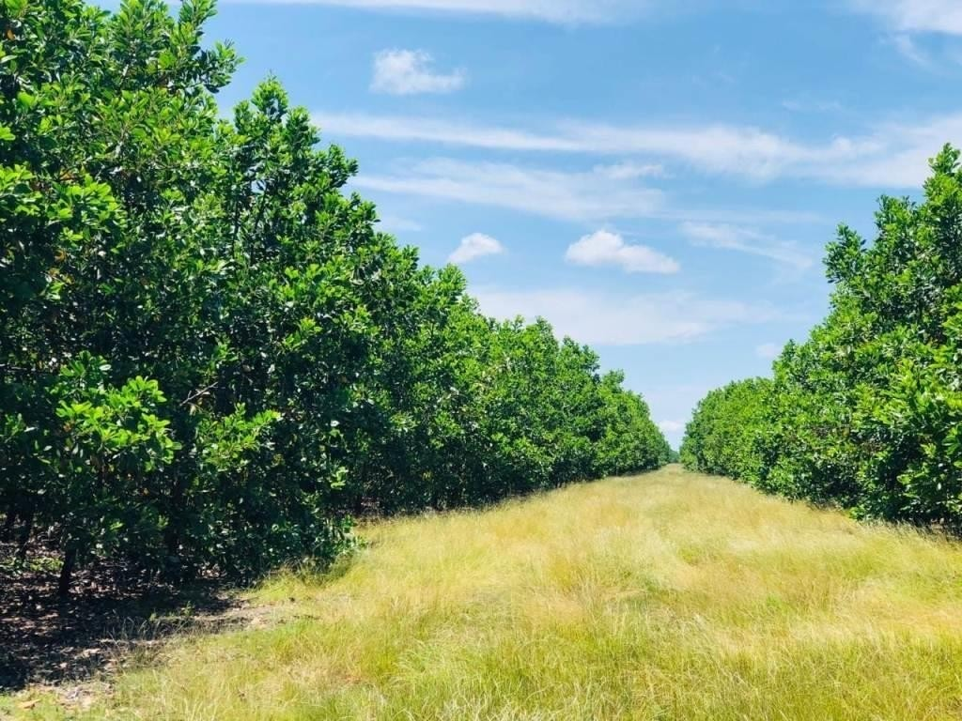
VERSION 09 – JANUARY 2023

Slide 2
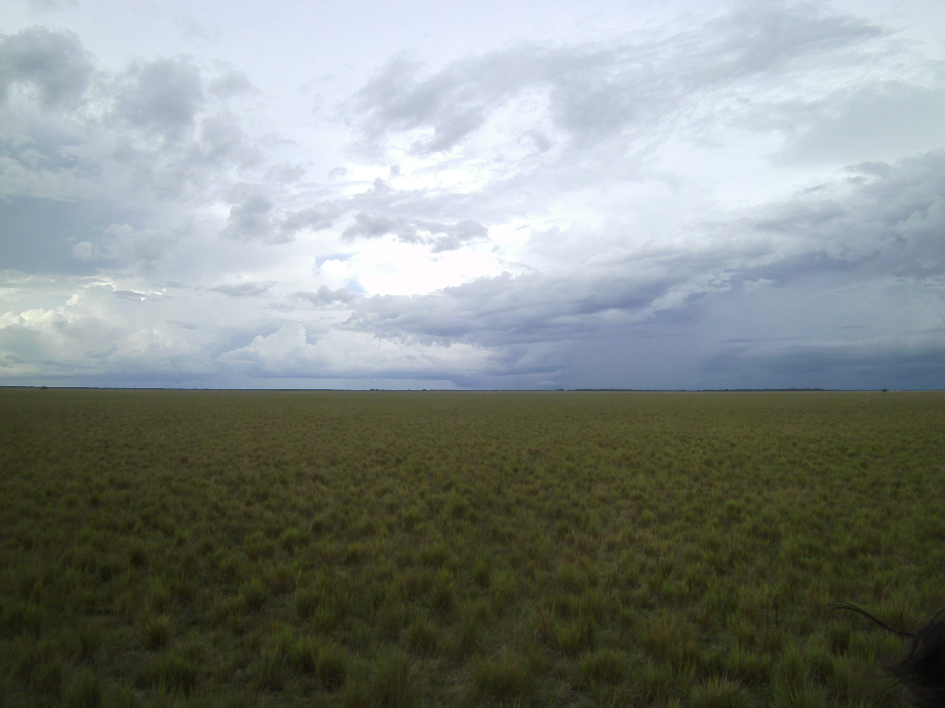
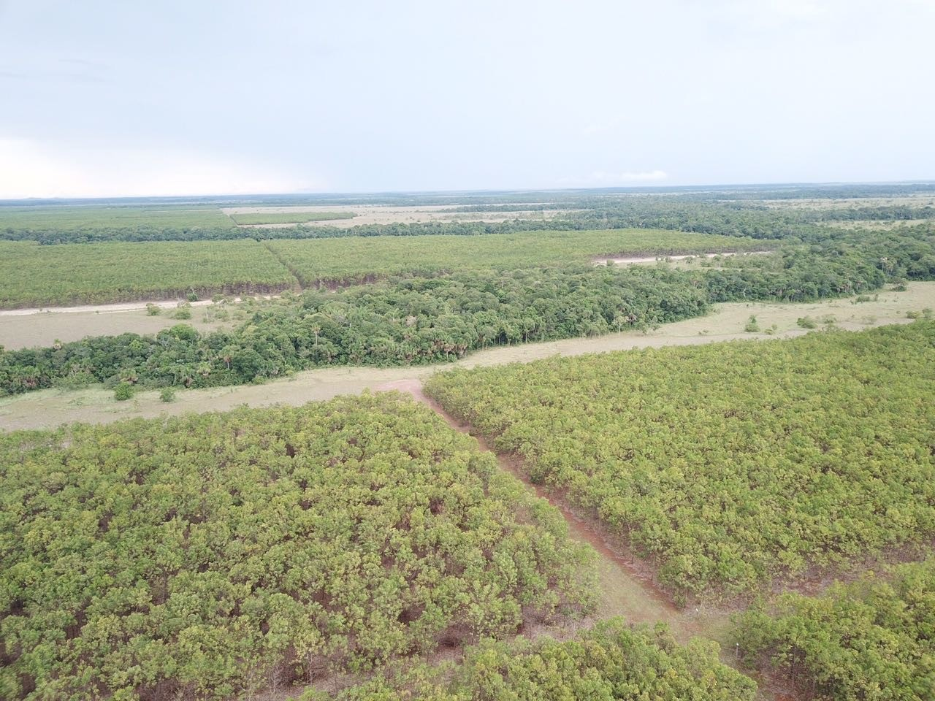
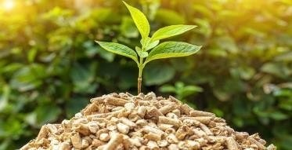
OUR HISTORY
INFORCOL was founded in 2013, Focussed on developing environmental and social responsibility projects, carrying out forestry activities in the department of Vichada with the conviction of generating development and growth in a region that has the full potential to become an economic engine of the country. All the development of our project is carried out on the Maracoa farm.
BEFORE
AFTER
SUSTAINABLE, ENVIRONMENTALLY RENEWABLE DEVELOPMENT

Slide 3
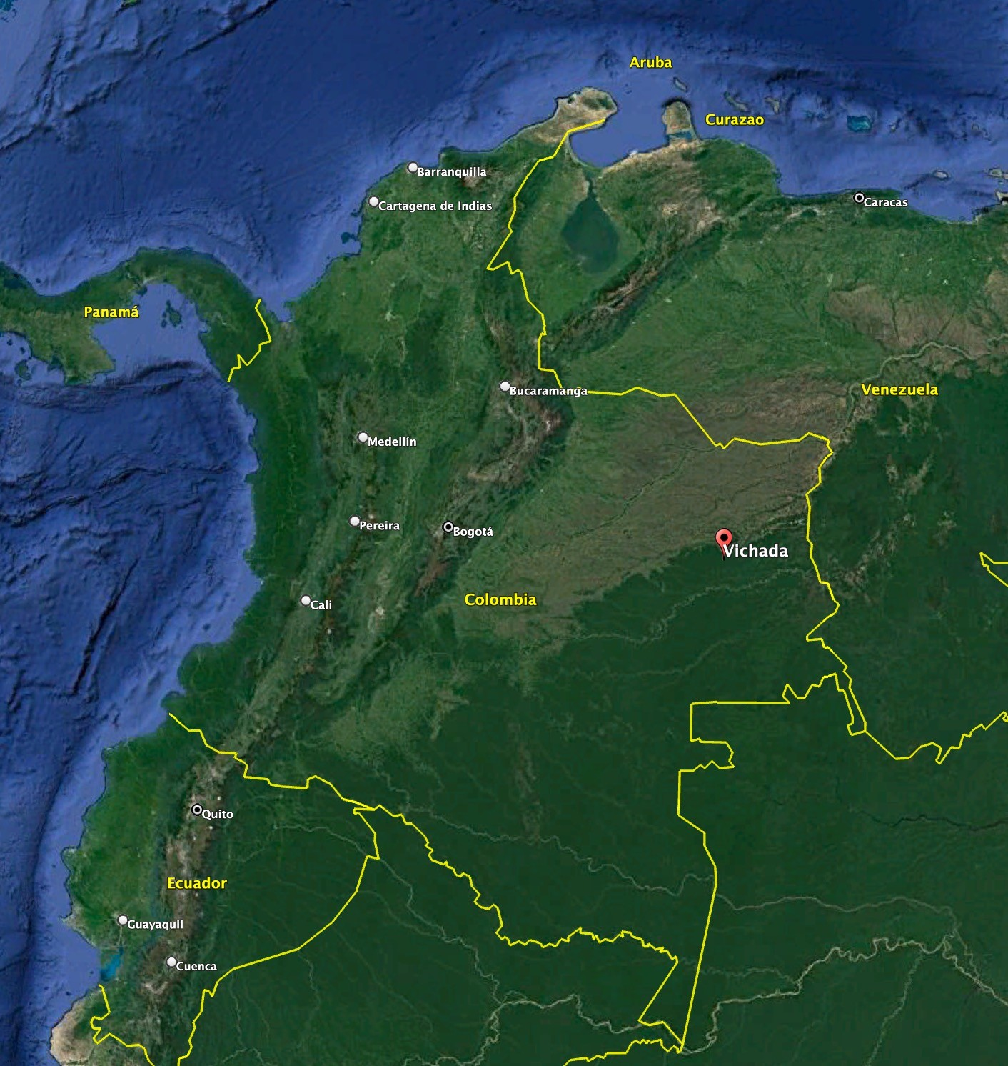
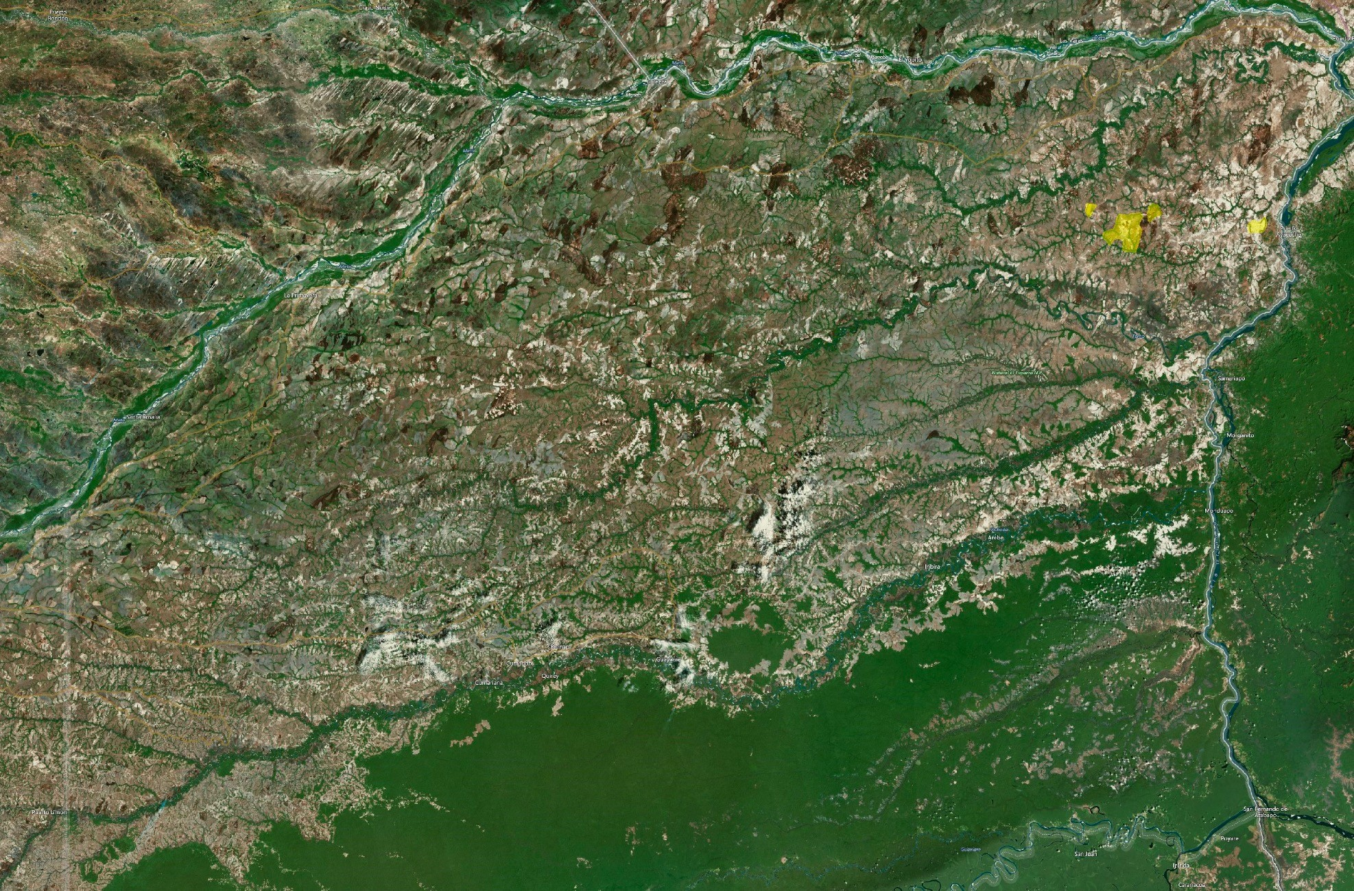
LOCATION
INFORCOL
The department of Vichada has 105,947 square km, is located in the east of the country, in the Orinoquía and Amazonia regions, bordering Casanare and Arauca to the north, Venezuela to the north and east, Guainía to the south, Guaviare to the southwest and West with Meta, it is the second largest department.

Slide 4
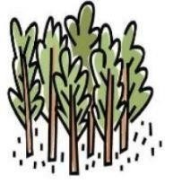
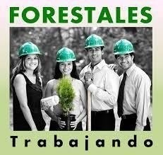
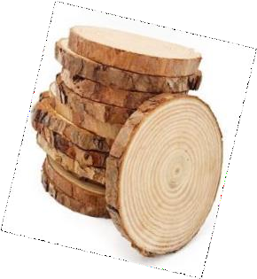
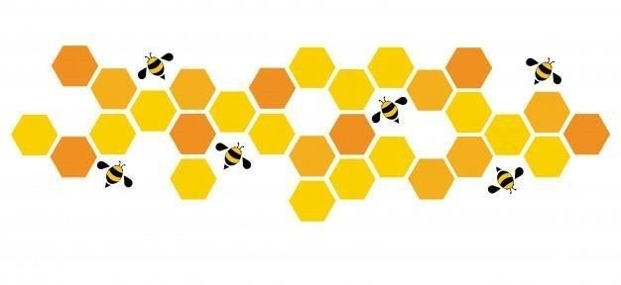
2023
FIGURES
308 Hectares of Protected Native Dry Tropical Forest
2.490.000 Trees Planted
7.211 Hectares of Land Available for Planting
10.329 Hectares of Titled Ptotected Land
30+ Direct and Indirect Jobs Generated
684.494 Tons of Wood – 2023 -2030
2.000 Ha Planted =
930.000 Tons of Co2.
252 Hives = Production of 6,57
Tons of Honey Per Year

Slide 5
We Have 2.000 Hectares Planted.
42%
58%
SPECIES | AMOUNT HA
ACACIA MANGIUM | 830,01
EUCALIPTO PELLITA | 1170,31
ACACIA MANGIUM EUCALIPTO PELLITA
List of Plantations Established Per Year
PROPERTY | 2013 | 2014 | 2015 | 2016 | 2017 | 2018 | 2019 | 2020 | 2021 | 2022 | TOTAL SOWED
LAS MERCEDES | 119,9 | 169,4 | 74,7 | 0 | 0 | 0 | 0 | 0 | 0 | 0 | 364
LAS DELICIAS | 0 | 137,62 | 254,2 | 0 | 0 | 0 | 0 | 63,5 | 0 | 0 | 455,32
LA TORMENTA | 0 | 0 | 0 | 0 | 40 | 0 | 0 | 0 | 0 | 0 | 40
MARACOA | 0 | 0 | 0 | 102,4 | 50,9 | 0 | 0 | 0 | 94 | 0 | 247,3
MARACOA 2 | 0 | 0 | 82,6 | 125,2 | 0 | 30 | 219 | 17 | 0 | 0 | 473,8
LA VEREMOS | 0 | 0 | 0 | 101,6 | 18 | 0 | 0 | 0 | 0 | 0 | 119,6
SAN ROQUE | 0 | 0 | 0 | 0 | 50 | 0 | 50 | 0 | 0 | 0 | 100
LOS MANGOS | 0 | 0 | 0 | 0 | 0 | 0 | 0 | 50 | 100 | 50 | 200
TOTALS | 119,9 | 307,02 | 411,5 | 329,2 | 158,9 | 30 | 269 | 130,5 | 194 | 50 | 2000,02

Slide 6
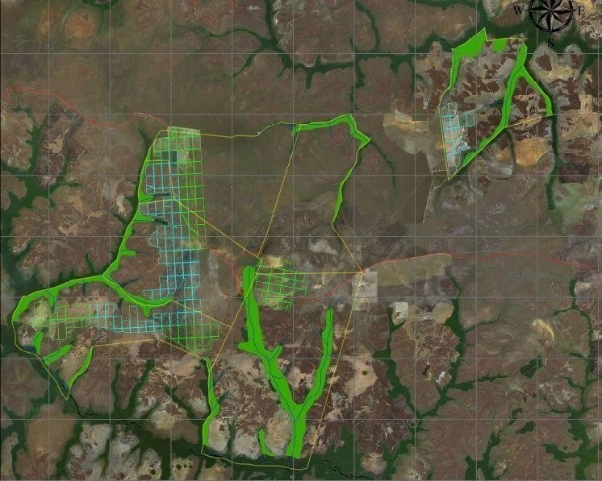
Plantations in the Following Properties:
PROPERTY | TOTAL SOWED | NET AREA OF THE PROPERTY
LAS MERCEDES | 364 | 1.206
LAS DELICIAS | 455,32 | 1.288
LA TORMENTA | 40 | 1.131
MARACOA | 247,3 | 2.722
MARACOA 2 | 473,8 | 1.252
LA VEREMOS | 119,6 | 1.000
SAN ROQUE | 100 | 1.209
LOS MANGOS | 200 | 300
TOTALS | 2000,02 | 10.108

Slide 7
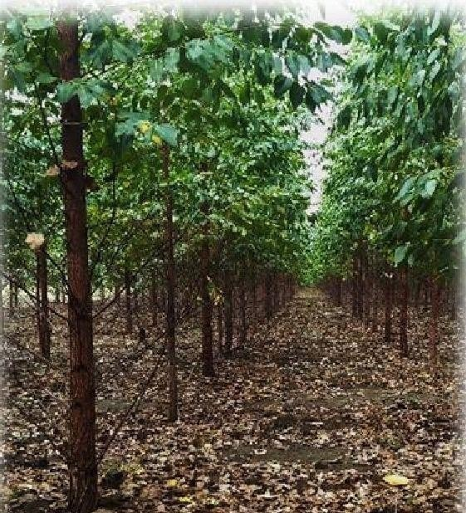
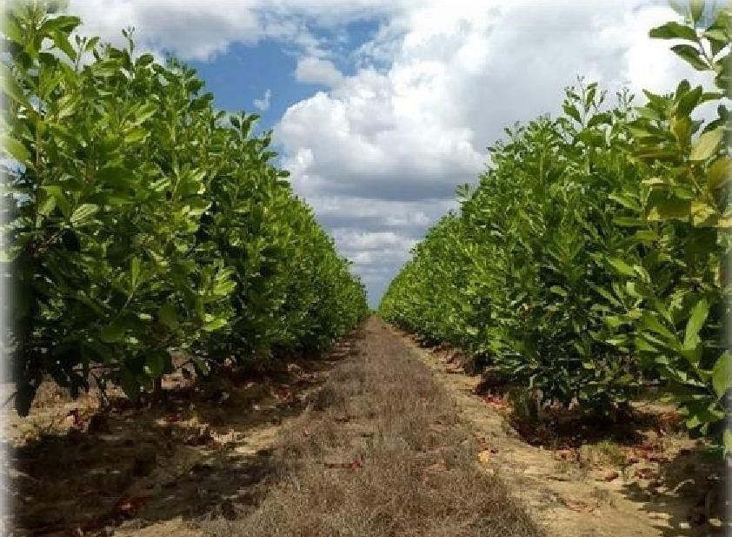
SPECIES
EUCALYPTUS PELLITA
Planted species are characterized by their ability to adapt and recover from poor and degraded soils.
ACACIA MANGIUM
They are also characterized by having a high density and high calorific value, fundamental properties for their use as BIOMASS.
The success of these species has been demonstrated in plantations in regions with characteristics similar to those of Vichada, such as Brazil and some countries in Central America.

Slide 8
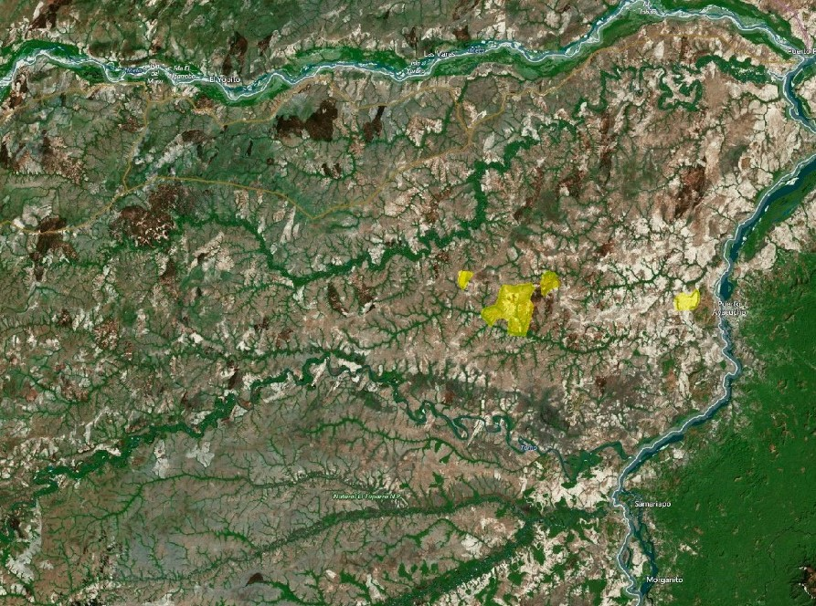
OPERATION
We focus on the establishment and management of commercial forest plantations:
Nursery.
Land preparation.
Species planting.
Maintenance: Fertilization, fumigation, realization of firewalls, monitoring and control of plantations.
Tree felling
Astorage.
Commercialization.
We Have:
9 properties with a total of 10,329 hectares.
we adjoin indigenous reservation but WE DO NOT PRESENT OVERLAPPING.

Slide 9
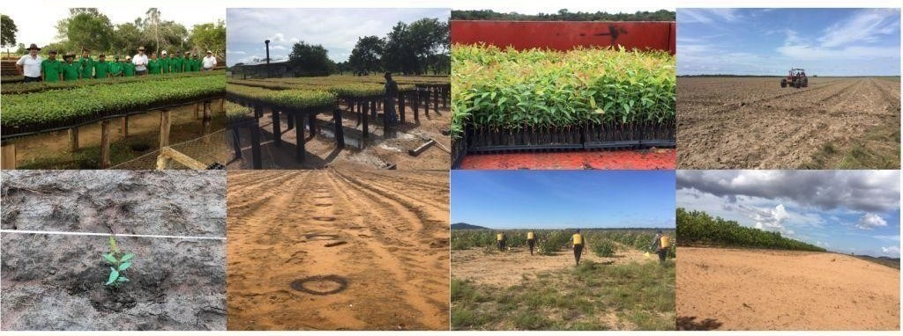
NURSERYERY
We have committed, trained personnel with extensive experience in carrying out operational and administrative activities.
GROUND PREPARATION
PLANTATION | FERTILIZATION | FUMIGATION | FIREWALL

Slide 10
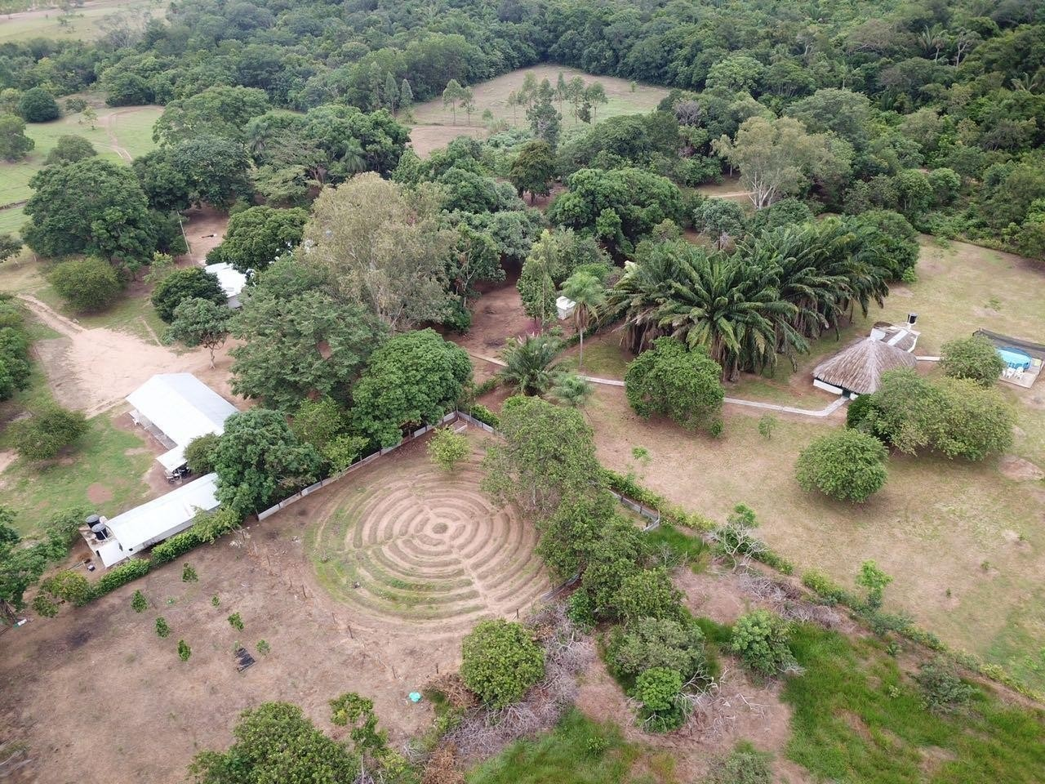
INFRASTRUCTURE AND EQUIPMENT
In our facilities you will find:
Nursery with a production capacity of 378,000 seedlings - 300 Ha
Fertilizer warehouse.
Agrochemical warehouse.
Warehouses of hand tools and machinery accessories
Fuel cellar.
Camping area.
House accommodation and bathrooms.
kiosk.
Eco point.
Tractors.
Agroindustrial machinery and vehicles.

Slide 11
WOOD AVAILABILITY
200.000
180.000
160.000
140.000
120.000
100.000
80.000
60.000
40.000
20.000
0
2.023 2.024 2.025 2.026 2.027 2.028 2.029 2.030
YEAR | TONS
2.023 | 35.970
2.024 | 92.106
2.025 | 123.450
2.026 | 172.830
2.027 | 56.963
2.028 | 15.750
2.029 | 114.975
2.030 | 72.450
TOTALS | 684.494

Slide 12
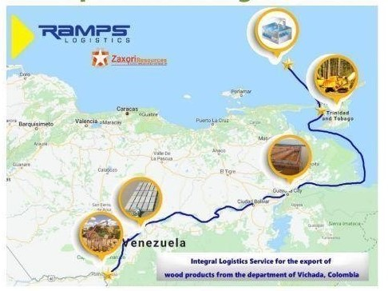
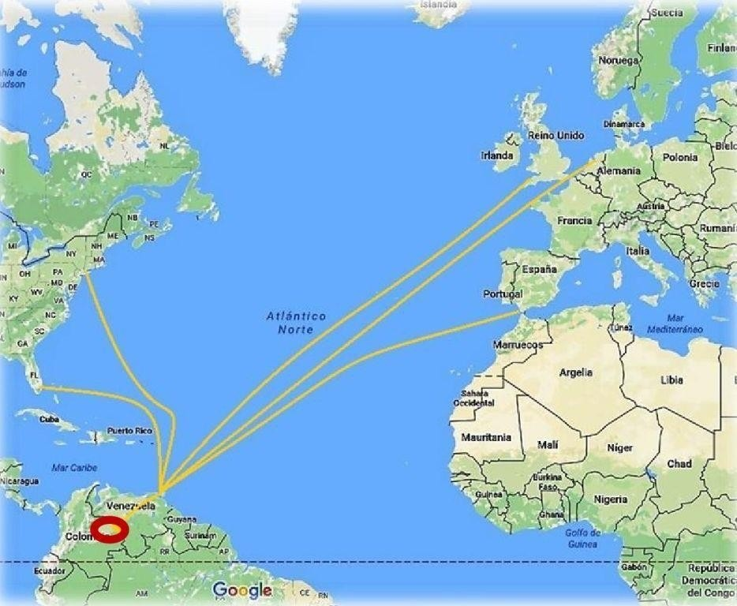
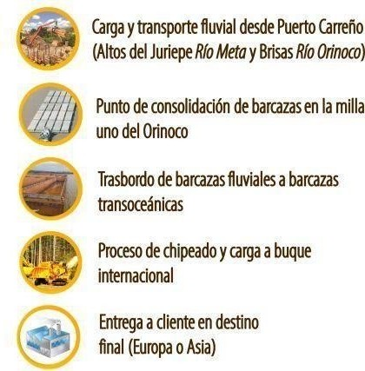
Our River Logistics Operation

Slide 13
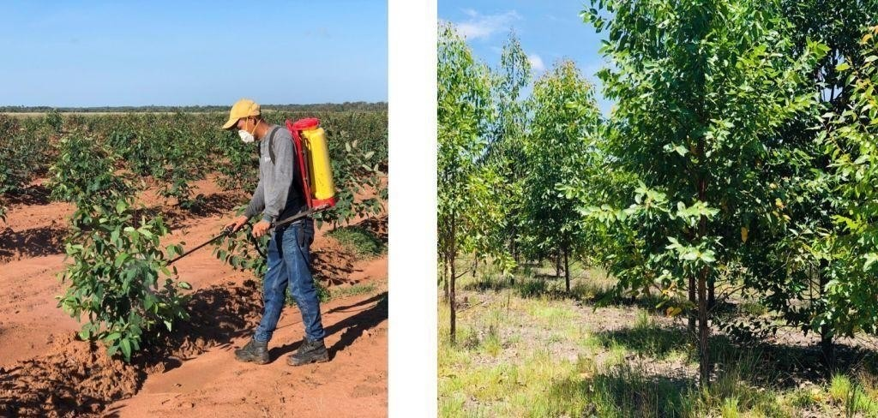
ESTABLISHMENT, MAINTENANCE AND MONITORING OF FOREST PLANTATIONS

Slide 14
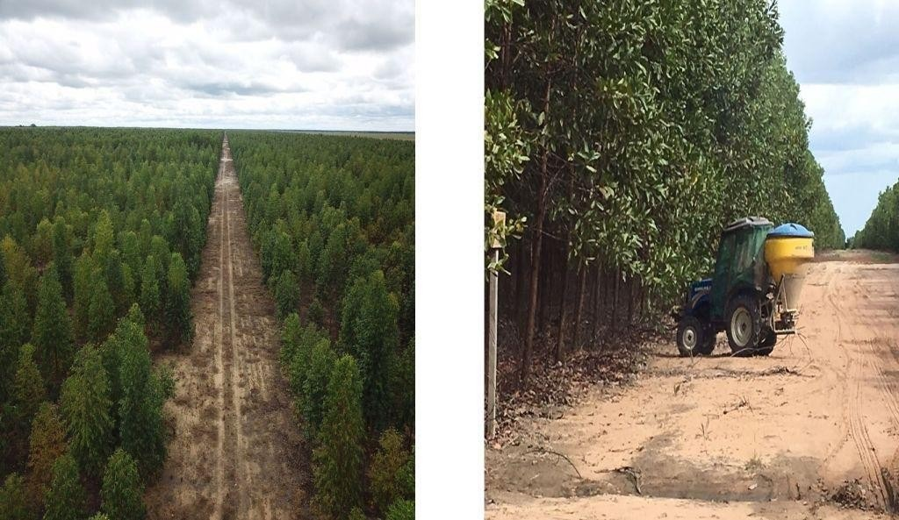

Slide 15
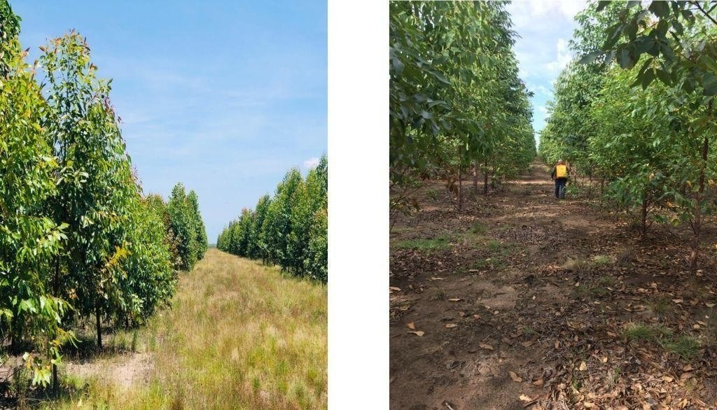

Slide 16
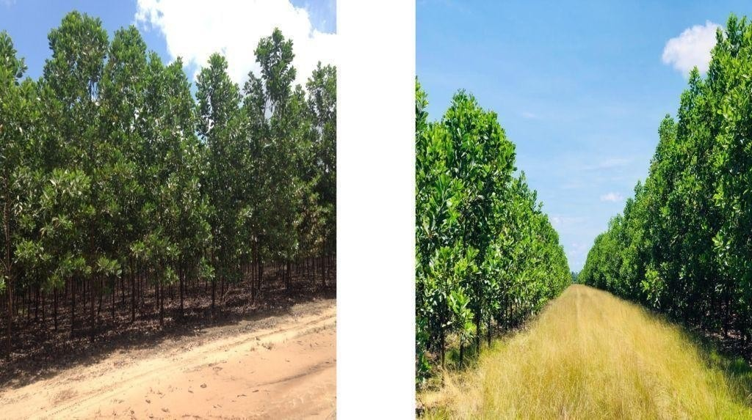

Slide 17
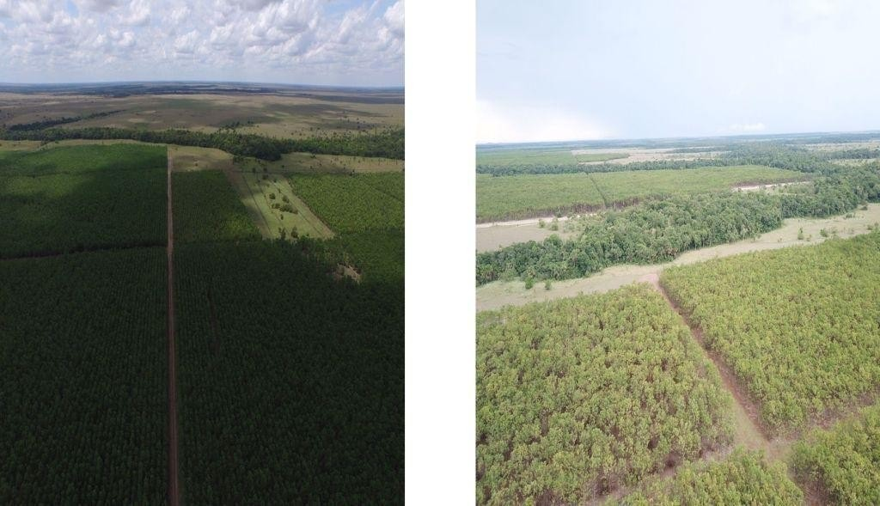

Slide 18
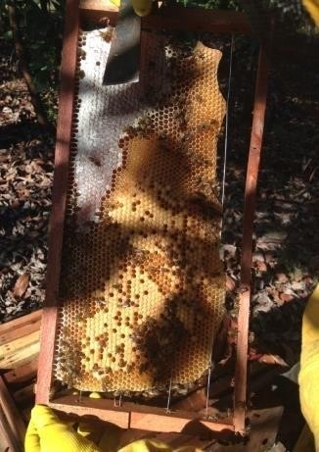
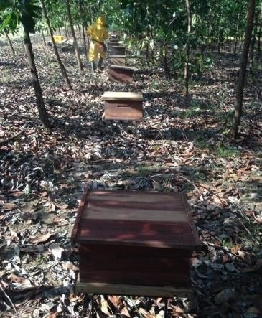
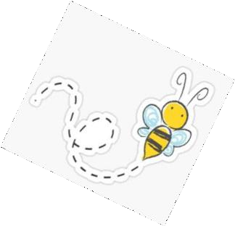
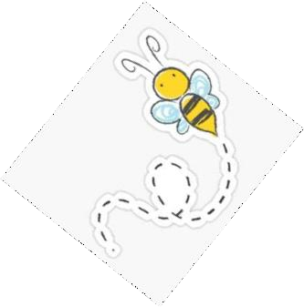
We have 252 hives for an annual production of 6 tons of honey
25,000 bees means that we have 3,000,000 bees in our apiaries

Slide 19
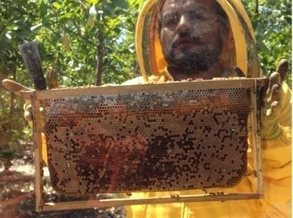
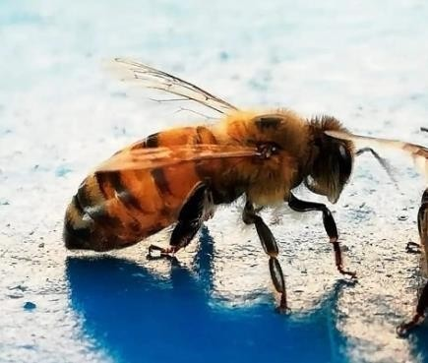
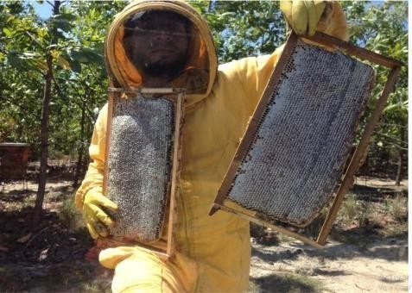
BEES
Bees are small in size, but they carry out an enormous ecosystem task, since their importance lies in the fact that thanks to the fact that they feed and transport pollen from one flower to another, thousands of plants can reproduce, survive and produce the food that living beings need. humans consume
Bees don't just make honey, they do something essential to the diversity of plants in the world: pollination. Its preservation and that of its habitat benefits us all
SUSTAINABLE, ENVIRONMENTALLY RENEWABLE DEVELOPMENT

Slide 20
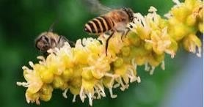
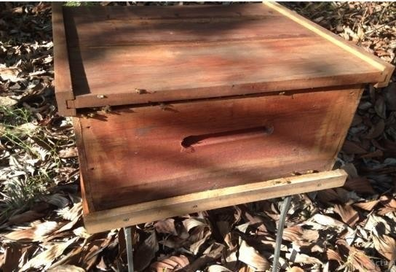
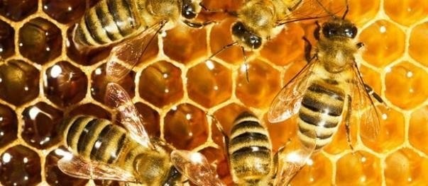
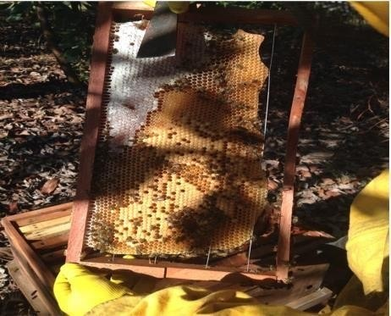
HONEY PRODUCTION PROCESS
Collection of nectar
from flowers
The bees go to the hives and transfer the nectar to the bees that process them.
Inside the hive, heat and air begin to be generated.
The beekeeper recovers the honey for its extraction and packaging
BENEFITS:
Reduces muscle pain.
Strengthens the immune system.
It is a natural antioxidant.
It is rich in vitamins and minerals.
Relieves sore throat and tonsillitis.
Help with the dispersion of Vegetative species

Slide 21
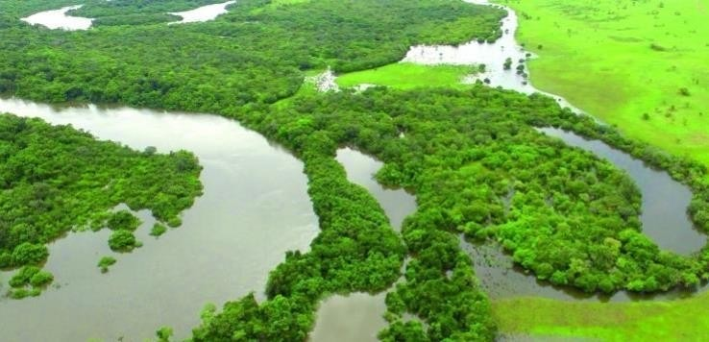
BITA RIVER - RAMSAR WETLAND
¿What does a Ramsar site mean?
These types of places are protected wetlands because they are considered cradles of
biological diversity. They are one of the most bio diverse environments in the world and a refuge for various species of flora and fauna.
The government promises to take measures to conserve them: adoption of management plans, establishment of improved urban and agricultural zoning, promotion of scientific research, among others.

Slide 22
The Bita River is a migration space for boreal, austral and neotropical birds; home to jaguars, pumas, primates, tapirs, dolphins and ornamental fish; also a refuge for the passage of aquatic fauna in constant exodus; territory with the greatest wealth of mammals in the country, and the widest diversity of beetle species.
424 species of plants.
3 freshwater sponges.
34 Dung Beetles.
87 of aquatic macroinvertebrates.
11 crustaceans including shrimp and crabs.
254 of fish.
19 amphibians.
38 of reptiles.
bird 201
63 MAMMALS.
The Bita, which is fed by more than 5,000 streams and small streams that make it up when they come together, is born in the municipality of La Primavera and flows into the Orinoco River.

Slide 23
